Slide 1

Small Group Tutoring (SGT) Process
MATH
Start Course

Slide 2
Objectives
01
Explore the essential principles and benefits of small group tutoring sessions.
Gain insights into the dynamics of effective small group learning environments.
Recognize the unique advantages and challenges associated with tutoring in a small group setting.

Slide 3

Small Group Tutoring (SGT)
SGT is when a tutor works with up to 3 students in a single session (3:1) 3 students per 1 tutor.

Slide 4
Features of SGT
The common room is accessible to all the students in the session whereas the breakout rooms are accessible specific to each student.
Tutors can see where each student is and move students in between common and breakout rooms.
A default color scheme is assigned for each student, and it can be used to differentiate the students’ work from one another on the common room.
Dual Chat Mode: In the common room the students can chat with the tutor as well as among them. In the breakout rooms the student can only chat with the Tutor.
Notifications: Tutors will get a notification on the specific breakout room tab for all the student’s activity.
Individual Feedback Form: After the session, tutors will be given individual tabs on the feedback form for each student, which they may use to fill out the feedback for each student.

Slide 5
Poll
This tool enables the tutor to initiate ﻿poll with multiple questions and can also save and use the poll later in the session.
A new option as well as a new question can be added.
Tutors as well as students can also minimize the poll.
An interesting feature of this poll is that it works irrespective of which whiteboard the students are placed on. If they are moved into the respective rooms the poll is visible to students even in the Breakout rooms.
The tutors can also see and use the whiteboard even when they are creating a poll.

Slide 6
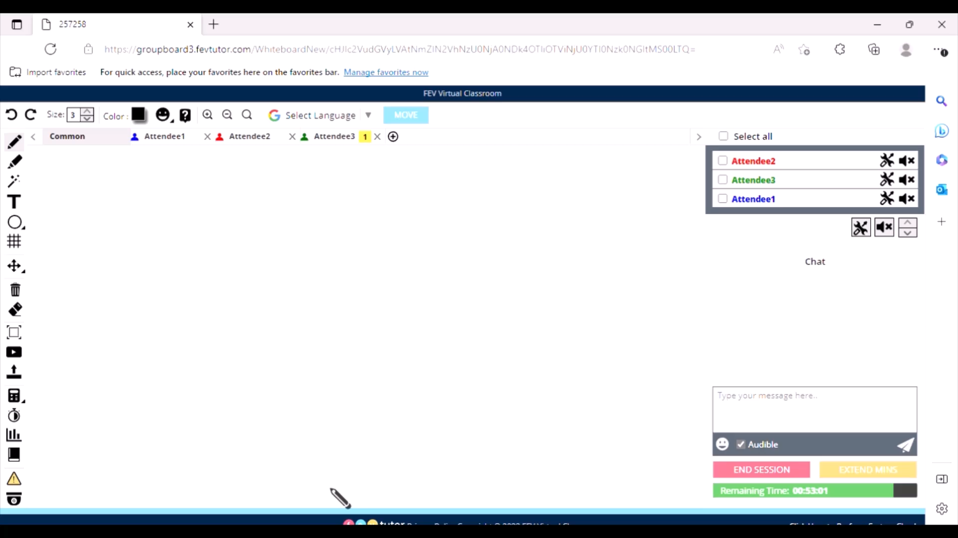
Control Panel
SGT Control Panel enables tutors to effectively manage 3:1 small group tutoring sessions and toggle efficiently between the main room and breakout rooms.
Have a look at this 2 min short video to check how it works.

Slide 7
Control Panel
When number of attendees are more than 1 and less then and equal to 3, the control panel is visible in the toolbox which enables small group tutoring for that session.
The tutor will be able to view all student WBs simultaneously, move between them efficiently and post individual student poll questions. This will limit student idle time, keep them engaged, and maximize learning and academic growth.
Tutors can toggle between the control panel view and the maximized student WB view immediately without delay.
Tutors can initiate ﻿polls for any single user. Individual students can close the poll window or close it automatically once submitted, instead of waiting for the tutor to end the poll for all. This allows students to go back to the whiteboard.
Control Panel View shows only active WB for each student
Tutors can chat with individual students from the Control Panel view.

Slide 8
Control Panel
How to use:
Click on ‘Control Panel’ icon in the toolbox on left side, to select the tool.
The control panel will open as shown below and this enable tutor to look at all students’ WB activities.
The tutor can also type chat text in common room for all students as well as in the breakout rooms for all 3 students.
Using chat and expand icons given at top right of each room in the control panel, the tutor can expand the respective WB view and can send chat to that attendee’s breakout room.
Using ‘Move’ button, tutors can also move a student to common room or breakout room.

Slide 9
Do’s
While greeting the students use generic scripts like “Hi, everyone”, “Welcome everyone”, “Hello and Welcome Everyone”, when all students are present in the session.
The Tutor should wait for a minute before beginning the class when all the assigned students fail to join the session on time.
The tutor will allow all the students to work in the common room for I Do and We Do sections. While posting the You Do and Exit Ticket questions, all the students will be moved to different breakout rooms.
Use the breakout rooms for specific instructions like CFU & practice questions and use common room for generic instructions like instructing to read the passage/poem, highlighting key terms, explaining tools.
Always work on the assigned topic/the ILP topic.
If any student goes offline or leaves the session after informing, post the appropriate acknowledgement script in the respective breakout room.
Tutor should wait till end of the session even if all the joined students goes offline.

Slide 10
Don’ts
Don’t use generic scripts to greet when there is only one student present in a GT session.
Never initiate one-way audio in group tutoring sessions even if requested by the student.
Don’t wait for all the students to join the session more than the recommended duration before beginning the lesson.
Don’t work on the lessons requested by the students.
Don’t review any lesson even if mastery is not achieved on the previous session topic.
Don’t award participation points in the common room.

Slide 11
Chat scripts and session recording for reference
Please click here to view the sample session chat script for your reference.
Please click here to view the sample session recording for your reference.

Slide 12



